Slide 1
SQL PROJECT
1
Name : Varadaraajan TS
Course : Master in Data science & Analytics with AI

Slide 2
About Project
2
The main objective of this project is to identify which state/Union Territory has recorded a maximum amount of accidents near Educational Institution, Residential Area, Religious Place, Factory and industrial area , Recreation place and cinema hall, Other places in rural urbanization and including Pedestrian crossing in urban urbanization in India.

Slide 3
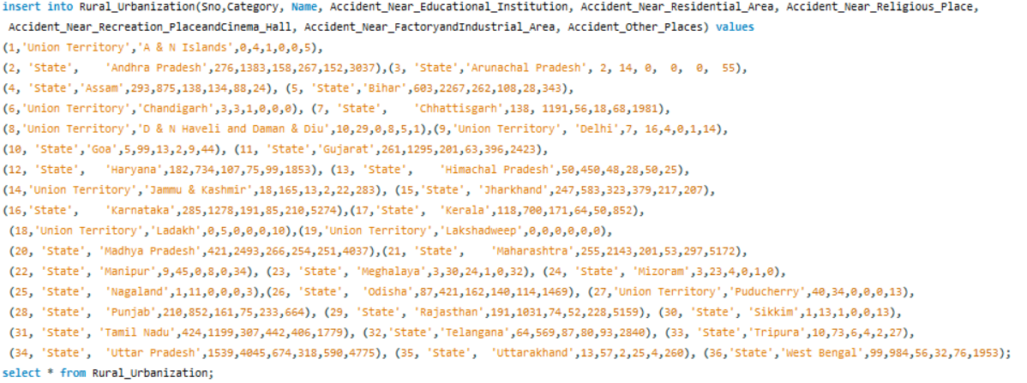
Implementation of DDL,DML
3
Creating table 1 (Rural_Urbanization)
Inserting Values in table 1 (Rural_Urbanization)

Slide 4
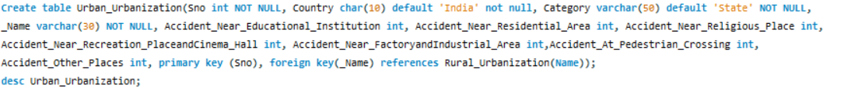
Implementation of DDL,DML
4
Creating table 2 (Urban_Urbanization)

Slide 5
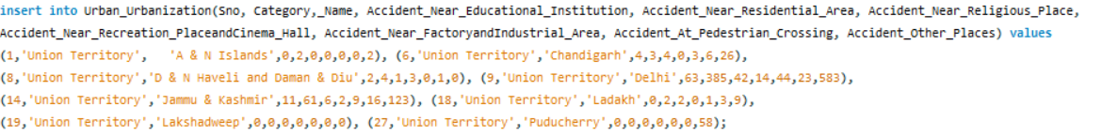
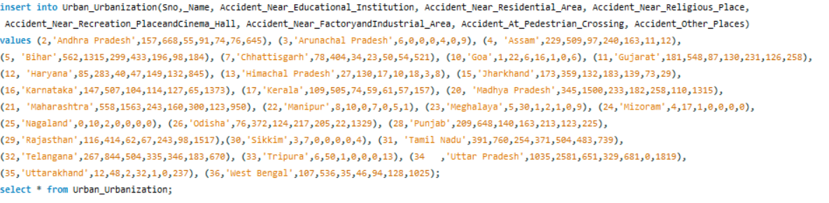
Implementation of DDL,DML
5
Inserting Values in table 2 (Urban_Urbanization)

Slide 6
Implementation of Constraints
6
Primary key, Default & Not Null
Foreign Key
Primary key, Default & Not Null

Slide 7
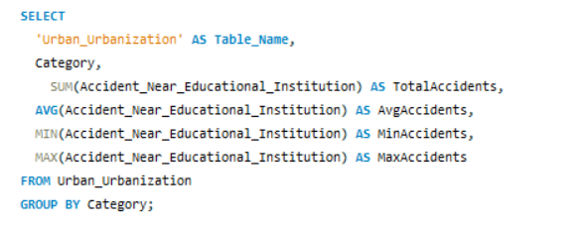
Implementation of Aggregate functions
7
Avg, Count, Max, Min, Sum

Slide 8
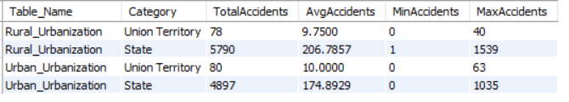
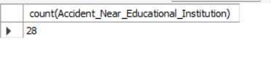
Implementation of Aggregate functions
8
Avg, Max, Min, Sum - Output
Count - Output

Slide 9
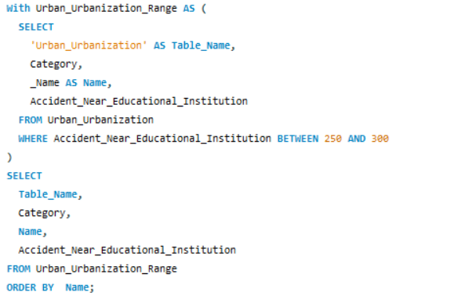

Implementation of Operators
9
Between & Order by

Slide 10


Implementation of Operators
10
Logical Operator
Relational Operator

Slide 11
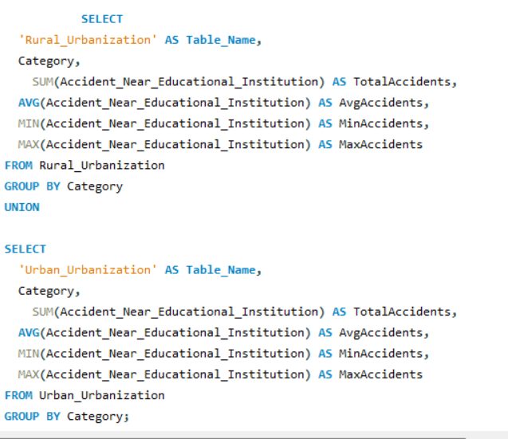
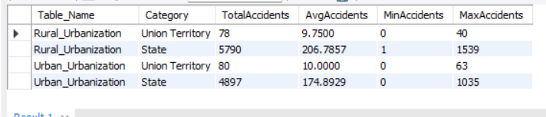
Implementation of Operators
11
Unary Operator (Union)

Slide 12
Implementation of CTE
12
Common Table Expression (CTE)
A CTE is a temporary named result set that is defined within the scope of a single SQL query.
It allows you to write complex queries in a more readable and maintainable manner, by breaking them down into smaller, logical steps.
In order to specify common table expressions
use a WITH clause that has one or more comma-separated subclauses.
Each subclause provides a subquery that produces a result set, and associates a name with the subquery.

Slide 13
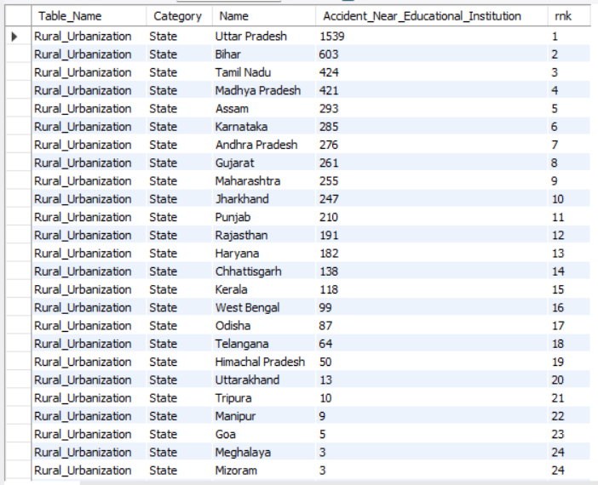
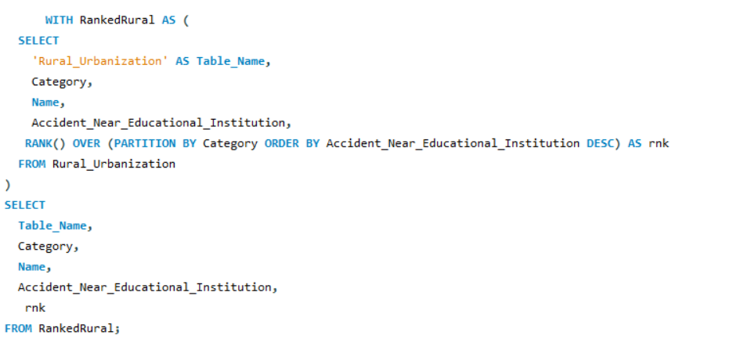
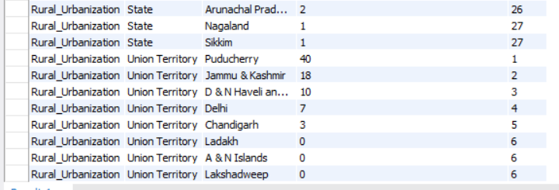
Implementation of CTE
13
Common Table Expression (CTE) For Ranking using Rank()

Slide 14
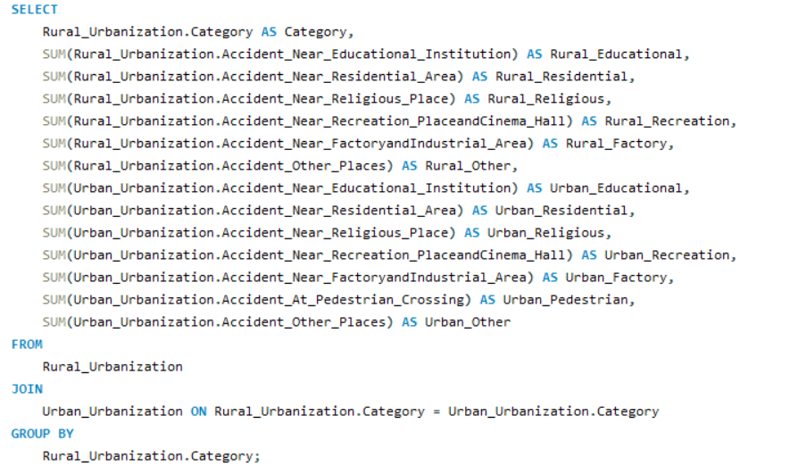
Implementation of Joins
14
Using Join Clause

Slide 15

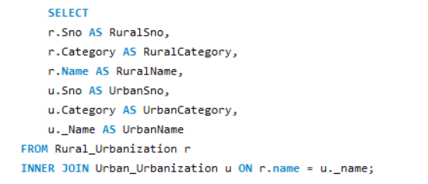
Implementation of Joins
15
Using Join Clause - Output
Inner Join

Slide 16
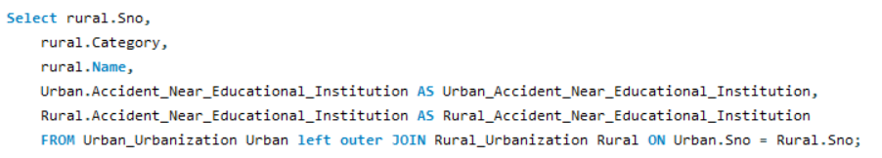
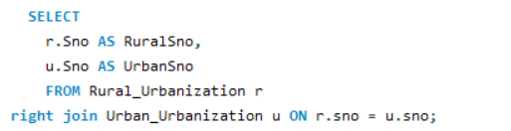
Implementation of Joins
16
Left Join
Right Join

Slide 17
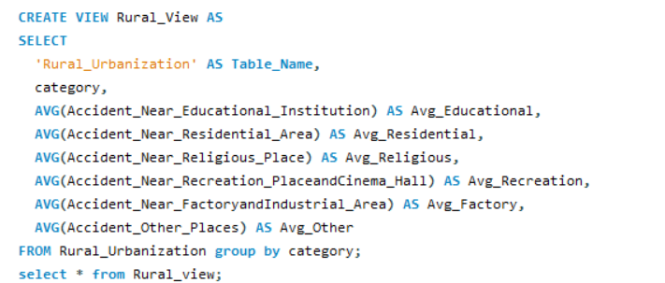
Implementation of View
17

Slide 18
Output of View Command
18

Slide 19
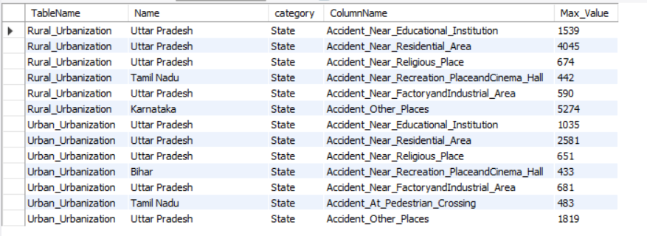
Analysis Result
19
Maximum amount of accidents around various places in both rural urbanization and urban urbanization is,

Slide 20
Conclusion
20
Uttar Pradesh has recorded maximum amount of accidents near Educational Institution, Residential Area, Religious Place, Factory and industrial area in both rural urbanization and urban urbanization.
Tamil Nadu has recorded maximum amount of accidents near Pedestrian crossing in urban, Recreation place and cinema hall in rural urbanization.
Bihar has recorded maximum amount of accidents near Recreation place and cinema hall in urban.
Karnataka has recorded maximum amount of accidents at other places in rural urbanization.
Compared to union territories, states recorded maximum amount of accidents near Educational Institution, Residential Area, Religious Place, Factory and industrial area , Pedestrian crossing, Recreation place and cinema hall, Other places in both rural urbanization and urban urbanization.

Slide 21
21
Thank You

